Slide 1
COVID Vaccine Tracker
File created on: 25-08-2023 09:53:41

Slide 2
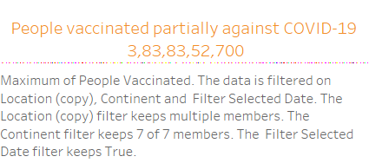

Slide 3
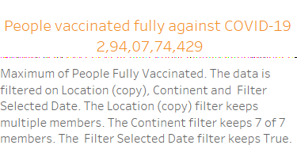

Slide 4
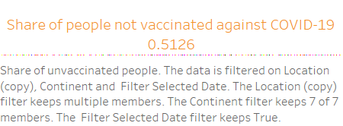

Slide 5


Slide 6
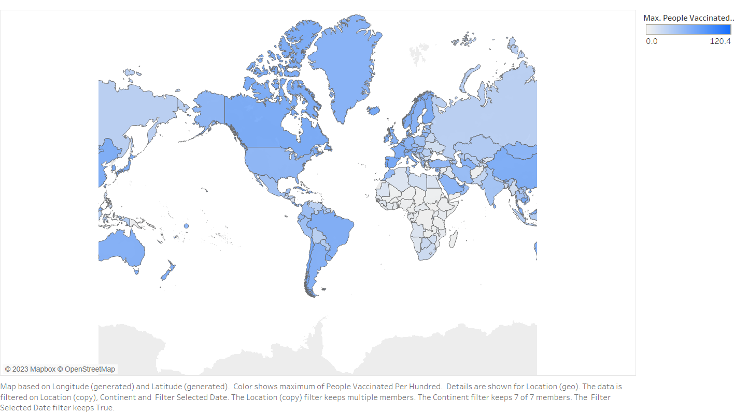

Slide 7
